Slide 1
Electrical double layer capacitor
Dr.M.Ratna Raju
Lecturer
Department of Physics
Andhra Christian College

Slide 2
Electrical Double Layer Capacitor
Introduction
Principle, construction and working of Ultracapacitor
Advantage, disadvantages and application

Slide 3
1. Introduction
In general, capacitor is a device to store the charge in an electric circuit.
Basically, a capacitor is made up of two conductors separated by an insulator called dielectric.
The
dielectric can be made
of paper, or nearly
plastic,
any
mica, other
ceramic,
glass, a vacuum
nonconductive material.
Some capacitors are called Electrolytic in which the
dielectric is aluminium foil conductor coated with oxide layer.

Slide 4

The electron storing capacity of capacitor is measured in unit Farads. One farad is approximately the charge with 6,280,000,000,000,000,000 electrons.
Definition: Ultracapacitors can be defined as a energy storage device that stores energy electro statically by polarising an electrolytic solution.
Unlike batteries no chemical reaction takes place when energy is being stored or discharged and so ultracapacitors can go through hundreds of thousands of charging cycles with no degredation.
Ultracapacitors are
also known as double-layer
capacitors or supercapacitors.

Slide 5
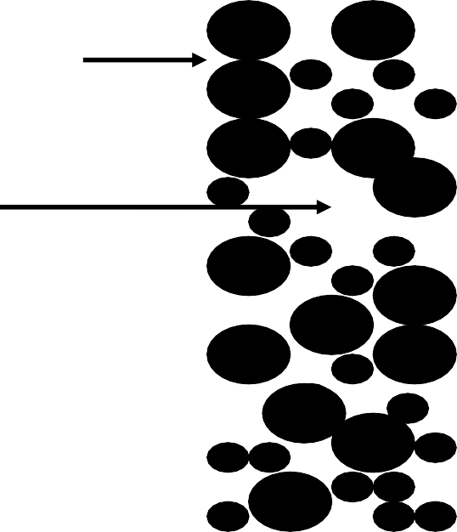




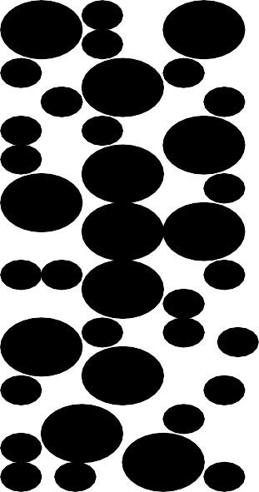
2. Principle, construction and working
Principle
Energy is stored in ultracapacitor by polarizing the electrolytic solution. The charges are separated via electrode –electrolyte interface.
Current Collector Electrolyte
Separator
Porous electrode
+
_

Slide 6
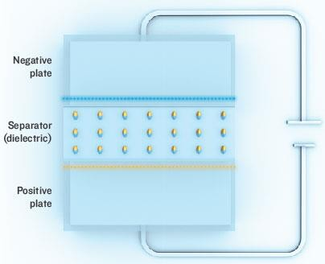
ULTRA CAPACITOR

Slide 7
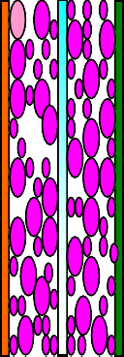
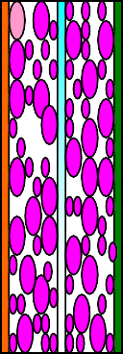
Construction
Ultracapacitor consist of a porous electrode, electrolyte
and a current collector (metal plates).
There is a membrane, which separates, positive and negative plated is called separator.
The following diagram shows the ultracapacitor module by arranging the individual cell
•
•
--
+
C 1
C 2
C 3
C 4
C 5
Ultracapacitor stack

Slide 8

Working
There are two carbon sheet separated by separator.
The geometrical size of carbon sheet is taken in such a way that they have a very high surface area.
The highly porous carbon can store more energy than
any other electrolytic capacitor.
When the voltage is applied to positive plate, it attracts negative ions from electrolyte.
When the voltage is applied to negative plate, it attracts
positive ions from electrolyte.

Slide 9

Therefore, there is a formation of a layer of ions on the both side of plate. This is called ‘Double layer’ formation.
For this reason, the ultracapacitor can also be called
Double layer capacitor.
The ions are then stored near the surface of carbon.
The distance between the plates is in the order of
angstroms.
According to the formula for the capacitance,
Dielectric constant of medium X area of the plate
Capacitance =
Distance between the plates

Slide 10

Ultracapacitor stores energy via electrostatic charges on
opposite surfaces of the electric double layer.
They utilize the high surface area of carbon as the storage medium, resulting in an energy density higher than conventional capacitors.
The purpose of having separator is to prevent the
moving across the electrodes.
energy much
charges
The amount of energy stored is very large as compared to a standard capacitor because of the enormous surface area created by the (typically) porous carbon electrodes and the small charge separation (10 angstroms) created by the dielectric separator

Slide 11

Diagram shows the formation of double layer
Electrolyte
---
---
---
---
---
---
---
---
+
+
+
+
+
+
+
+
▬
+
−
+
+
+
− −
+
−
Separator
+
−
−
+
−
+
+
−
Electric double layer

Slide 12

Advantage
Long life: It works for large number of cycle wear and aging.
Rapid charging: it takes a second to charge
without
completely compared to
Low cost: it is less expensive as
electrochemical battery.
High power storage: It stores huge amount of energy in a small volume.
Faster release: Release the energy much faster than battery.

Slide 13

Disadvantage
They have Low energy density
Individual cell shows low voltage
Not all the energy can be utilized during discharge
They have high self-discharge as compared to battery.
Voltage balancing is required when more than three capacitors are connected in series.

Slide 14

Applications
They are used in electronic applications such as cellular electronics, power conditioning, uninterruptible power supplies (UPS),
They used in industrial lasers, medical equipment.
They are used in electric vehicle and for load leveling to
extend the life of batteries.
They are used in wireless communication system for uninterrupted service.
There are used in VCRs, CD players, electronic toys, security systems, computers, scanners, smoke detectors, microwaves and coffee makers.

